Slide 1


Front end
(Introduction to css)
Lecture-13

Slide 2

Today’s Agenda
Handling Font In CSS
Various Font Properties
What Are Google Fonts
How To Use Google Fonts ?
How To Use Font Awesome ?

Slide 3
Handling Font In CSS
CSS provide several properties for styling the font of the text, including changing their face, controlling their size and boldness.
There are 5 properties for setting font and they are:
font-family
font-style
font-weight
font-size
font-variant

Slide 4
The Font-Family Property
The font-family property is used to specify the font to be used to render the text.
There are 3 ways to apply font:
Single Font Name:
body
{
font-family: Verdana;
}

Slide 5
The Font-Family Property
Font Family Keywords
body
{
font-family: serif;
}
Multiple Font Names
body
{
font-family: Verdana,Arial,Helvetica,sans-serif;
}

Slide 6
CSS Font Groups
Font Group Name | Font Names
Sans Serif | Arial, Arial Black, Trebuchet, Verdana
Serif | Georgia, Times New Roman
Monospace | Courier New, Andale Mono
Cursive | French Script MT, Comic Sans MS, Bradley Hand ITC
Fantasy | Impact, Stencil

Slide 7
Web Safe Fonts
Web safe fonts are fonts that are included with most operating systems.
It means that using these fonts into our code will result in consistent rendering across devices and operating systems.

Slide 8
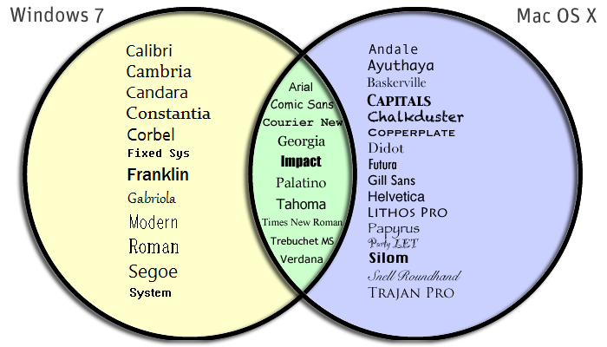
Most Common Web Safe Fonts

Slide 9
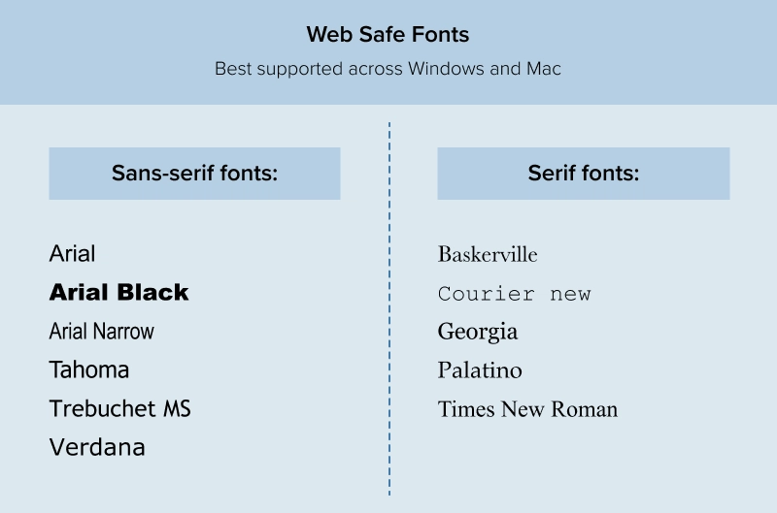
Most Common Web Safe Fonts

Slide 10
The Font-Style Property
The font-style property is used to set the font face style for the text content of an element.
The font style can be:
normal
italic
oblique
The default value is normal.

Slide 11

Oblique v/s Italic
The Oblique Style uses the same font as Normal (non-italic version of the font-type / font-face) but skews (slants) it to the right before presenting it to the screen.
While the Italic Style uses a Italic type/version of the font, most of the time almost all fonts have a Italic version of the font which has special characters defined for it

Slide 12
The Font-Style Property
p.normal
{
font-style: normal;
}
p.italic
{
font-style: italic;
}
p.oblique
{
font-style: oblique;
}

Slide 13
The Font-Size Property
The font-size property is used to set the size of font for the text content of an element.
There are several ways to specify the font size values like:
Using pixels
Using em or percentage
Using special keywords

Slide 14
Setting Font Size With Pixels
Setting the font size in pixel values (e.g. 14px, 16px, etc.) is a good choice when we need accuracy.
Pixel is an absolute unit of measurement which specifies a fixed length.

Slide 15
Setting Font Size With em
The em unit refers to the font size of the parent element.
When defining the font-size property, 1em is equal to the size of the font that applies to the parent of the element.
So, if we set a font-size of 20px on the body element, then 1em = 20px and 2em = 40px.
However, if we haven't set the font size anywhere on the page, then it is the browser default, which is normally 16px.

Slide 16
Example
h1
{
font-size: 3em; /* 48px/16px=3em */
}
p
{
font-size: 0.875em; /* 14px/16px=0.875em */
}

Slide 17
Setting Font Size With Keywords
CSS provide several keywords that we can use to define font sizes.
An absolute font size can be specified using one of the following keywords:
xx-small /*equivalent of 9 pixels*/
x-small /*equivalent of 10 pixels*/
small /*equivalent of 13 pixels*/
medium /* equivalent to the browsers default font-size*/
large /*equivalent of 18 pixels*/
x-large /*equivalent of 24 pixels*/
xx-large. /*equivalent of 32 pixels*/
Whereas relative fonts can be specified using the keywords: smaller or larger

Slide 18
Example
body
{
font-size: large;
}
h1
{
font-size: larger;
}
p
{
font-size: smaller;
}

Slide 19
The Font-Weight Property
The font-weight property specifies the weight or boldness of the font.
This property can take one of the following values:
normal
bold
bolder
lighter
100, 200, 300, 400, 500, 600, 700, 800, 900 and
inherit

Slide 20
The Font-Weight Property
The numeric values 100-900 specify the font weights, where each number represents a weight which is greater than its predecessor.
400 is same as normal & 700 is same as bold.
The bolder and lighter values are relative to the inherited font weight, while the other values such as normal and bold are absolute font weights.

Slide 21
Example
p
{
font-weight: bold;
}

Slide 22
The Font-Variant Property
The font-variant property allows the text to be displayed in a special small-caps variation.
Small-caps or small capital letters are slightly different to normal capital letters, in which lowercase letters appear as smaller versions of the corresponding uppercase letters.

Slide 23
Example
p
{
font-variant: small-caps;
}

Slide 24
What Are Google Fonts ?
Google Fonts launched in 2010 , are free, open-source selection of fonts.
The Google Fonts website makes it easy for anyone to quickly select and utilize various different fonts for their own design needs.
Currently 1531 collection of fonts is available at the Google Fonts website

Slide 25
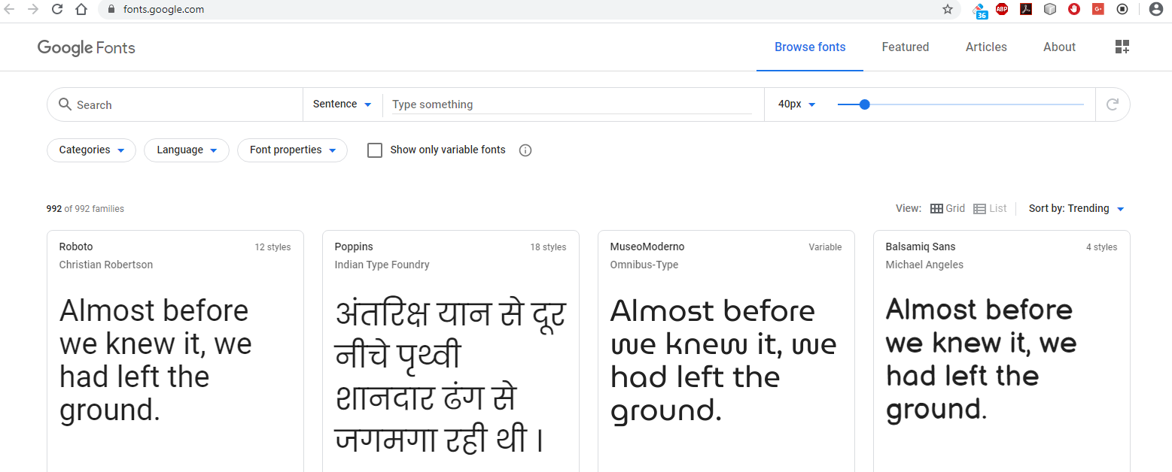
How To Use Google Fonts ?
1) Go to the Google Fonts website
Visit the Google Fonts website where we will be able to choose from 1531 font families and counting!

Slide 26
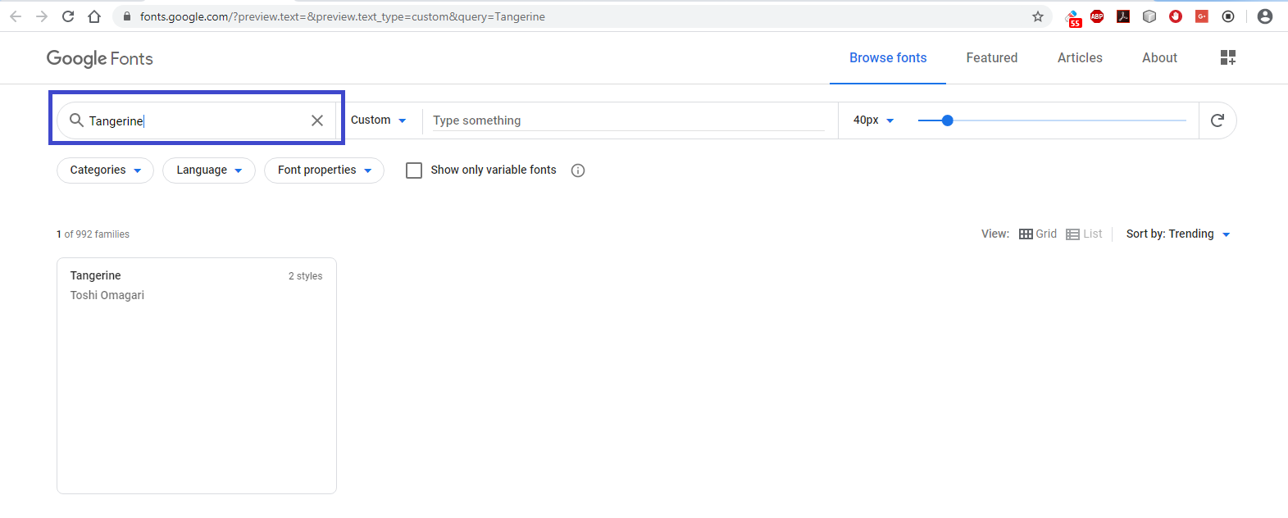
How To Use Google Fonts ?
2) Search for fonts
If we have a font family name in mind we can search for it.

Slide 27
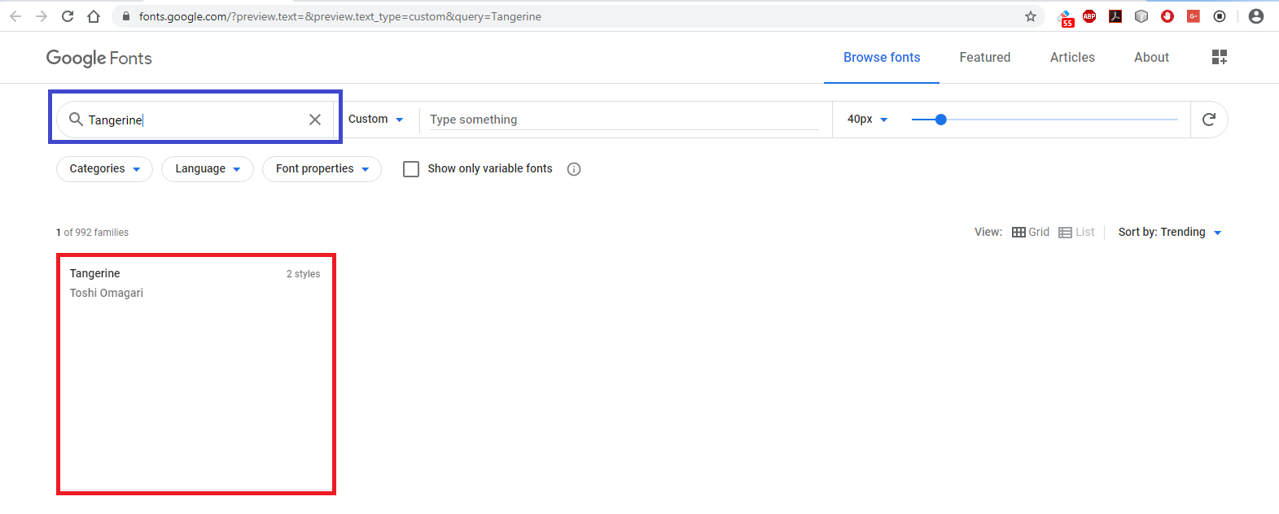
How To Use Google Fonts ?
3) Click on the Font Box when you are ready to use it
Each font family has a Font Box. Click the FontBox to preview it.

Slide 28
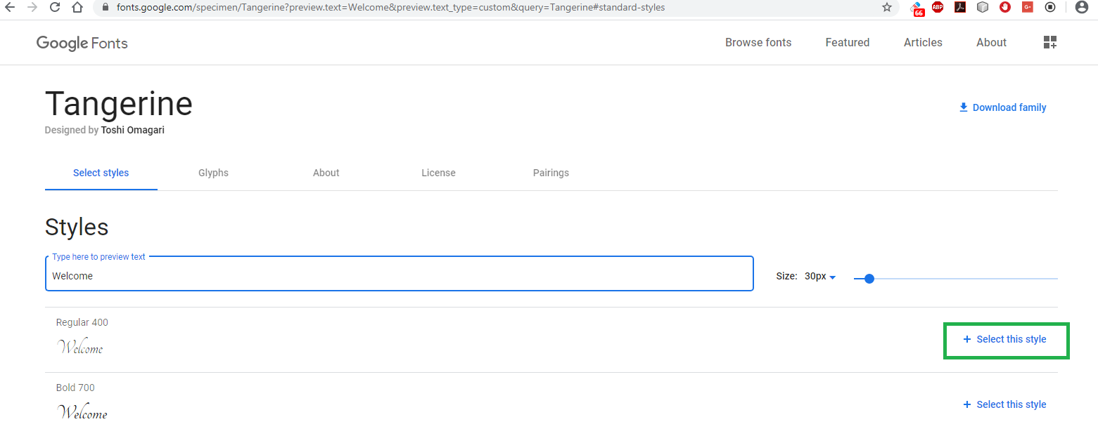
How To Use Google Fonts ?
4) Click the “select this style” to show all the fonts you’ve chosen
The next window will show you all the styles available for the font family you have selected. Click on the style you want.

Slide 29
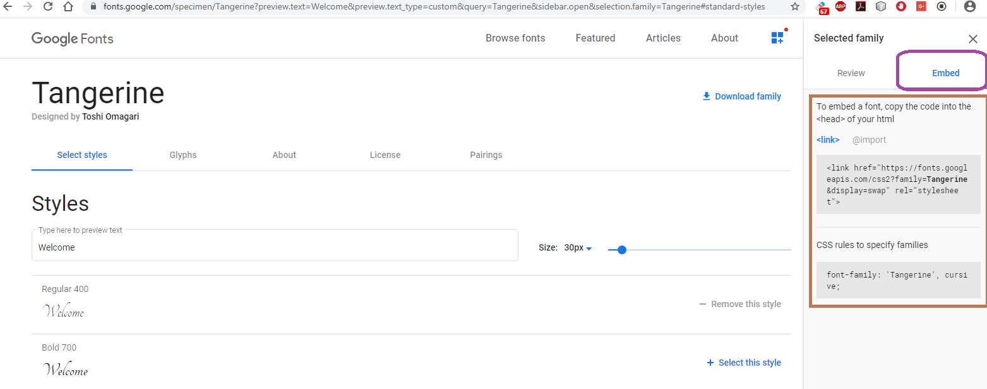
How To Use Google Fonts ?
5) Click on “embed” to show HTML and CSS code
On the next window you have to click on embed which will display the HTML and CSS code we have to insert in our web page to use this font.

Slide 30
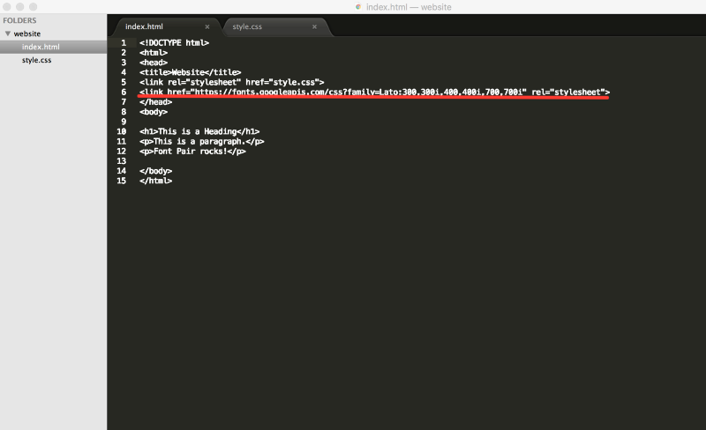
How To Use Google Fonts ?
6) Copy the HTML code and paste it in your website’s <head>
Copy and paste the HTML and CSS code into our website. First, copy the HTML link into the head of our HTML page.

Slide 31
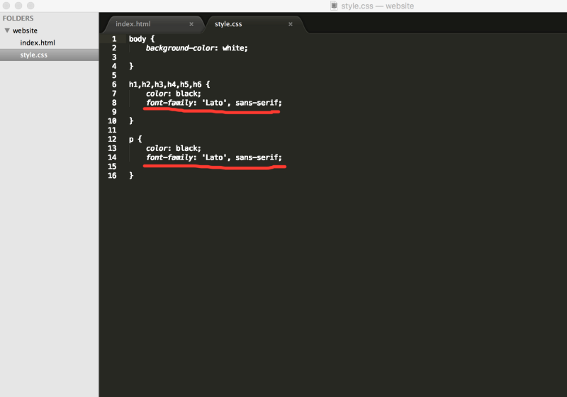
How To Use Google Fonts ?
7) Copy the CSS rule and paste it in your website’s CSS file
Finally, we also need to copy and paste the CSS rules into our CSS file.

Slide 32
What Is Font Awesome ?
Font Awesome is an icon toolkit with 2020 free icons and 26,107 paid icons that are incredibly easy to use.
The icons were created using a scalable vector and inherit CSS sizes and color when applied to them.
This makes them high-quality icons that work well on any screen size.

Slide 33

How To Use Font Awesome?
1) Go to the Font Awesome Website
Visit the Font Awesome website where we will be able to choose from 2020 icons and counting!

Slide 34

How To Use Font Awesome?
2) Register
Click on start for free
Fill the email and click on send kit code

Slide 35

How To Use Font Awesome?
3) Confirm your registration
Go to your inbox, open the mail from fontawesome and click on confirm your email address

Slide 36

How To Use Font Awesome?
4) Set up your password and login
After logging in you will be redirected to kit page.
Click on the kit code to get the <script> tag

Slide 37
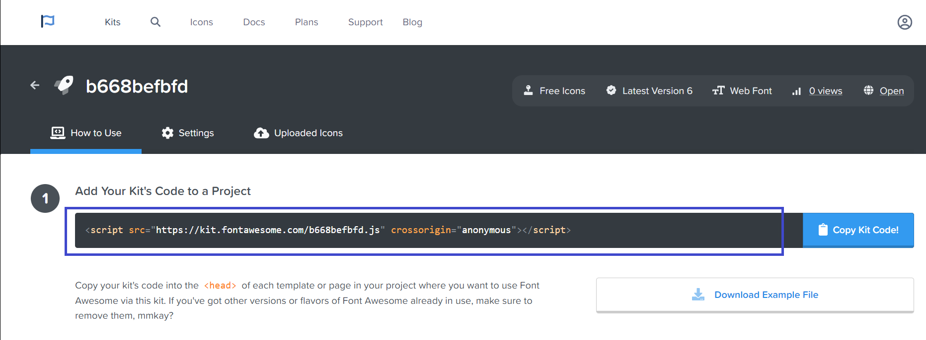
How To Use Font Awesome?
5) Copy and paste
Copy the <script> tag
Paste it in the <head> section of your page

Slide 38
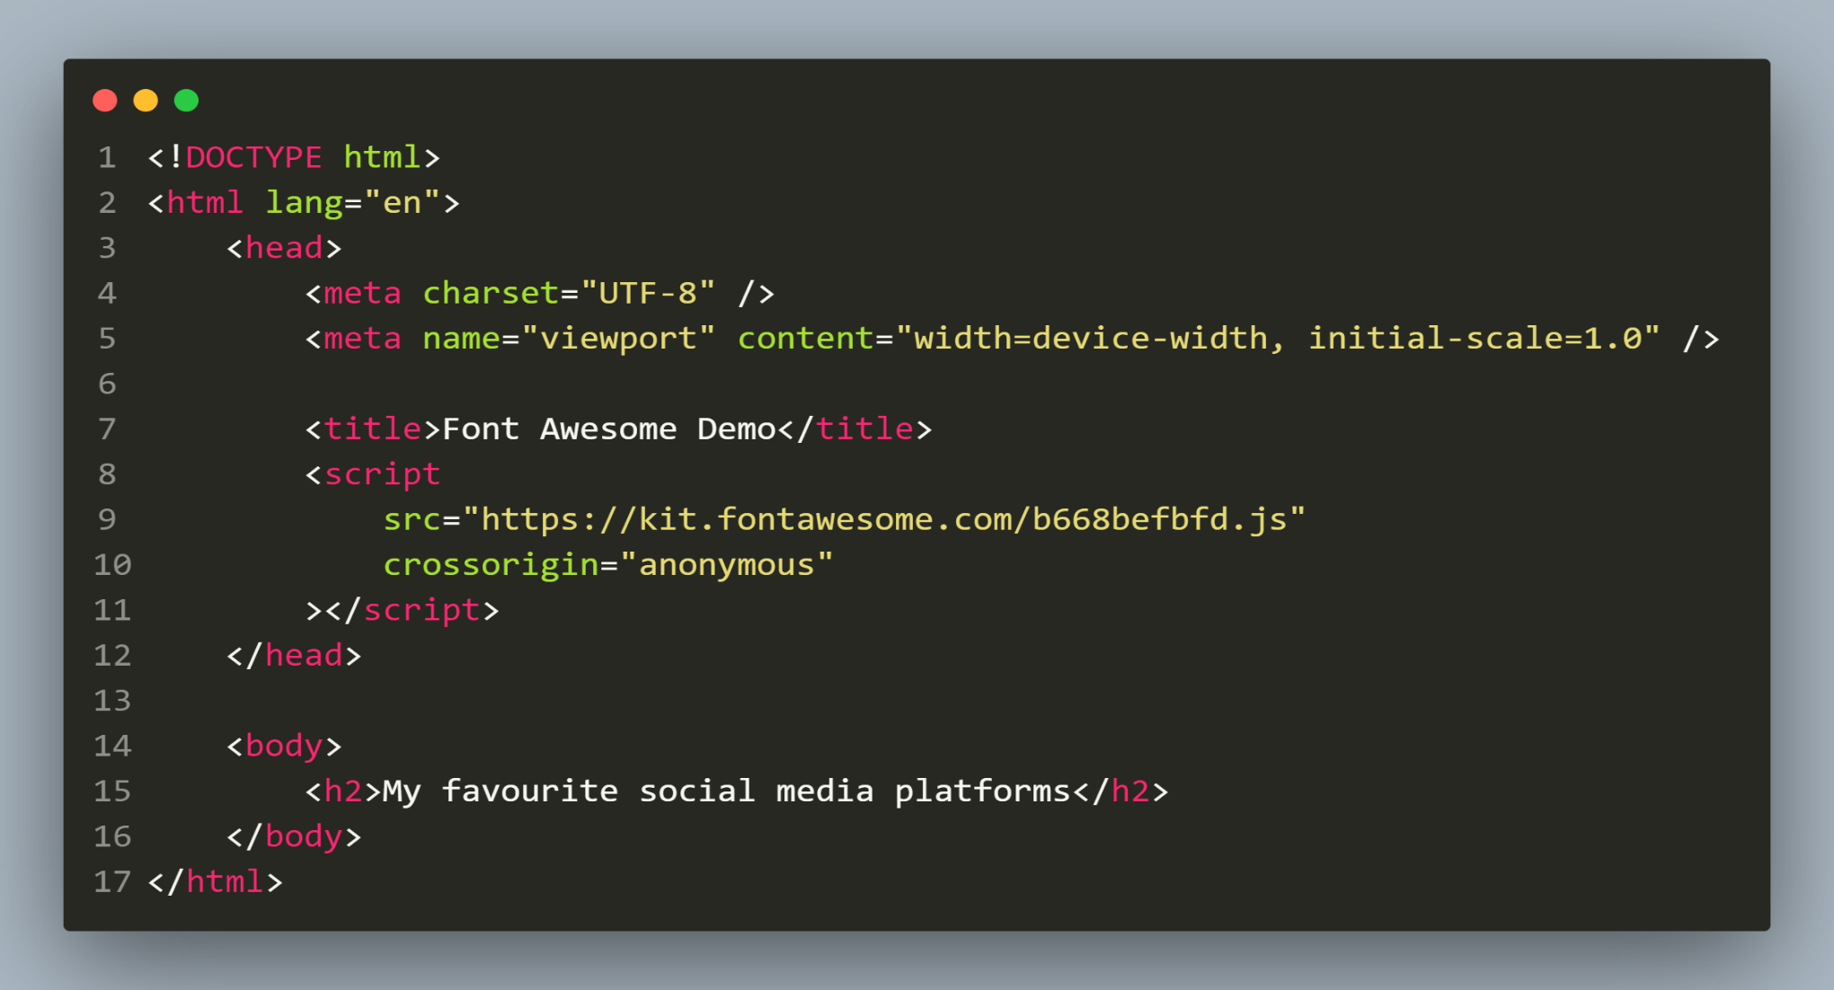
Our Starter Code

Slide 39
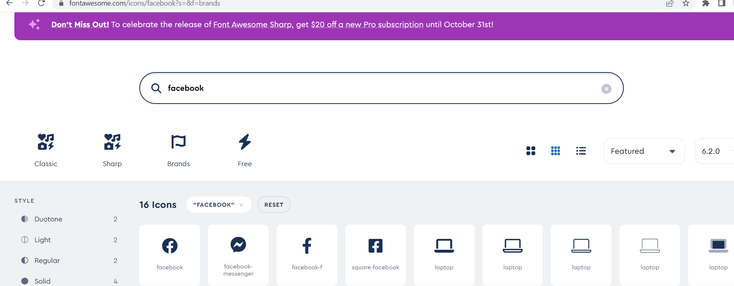
How To Use Icons ?
6) Goto Icons Page and search
Open the icons tab on the fontawesome website
Search for the desired icon

Slide 40
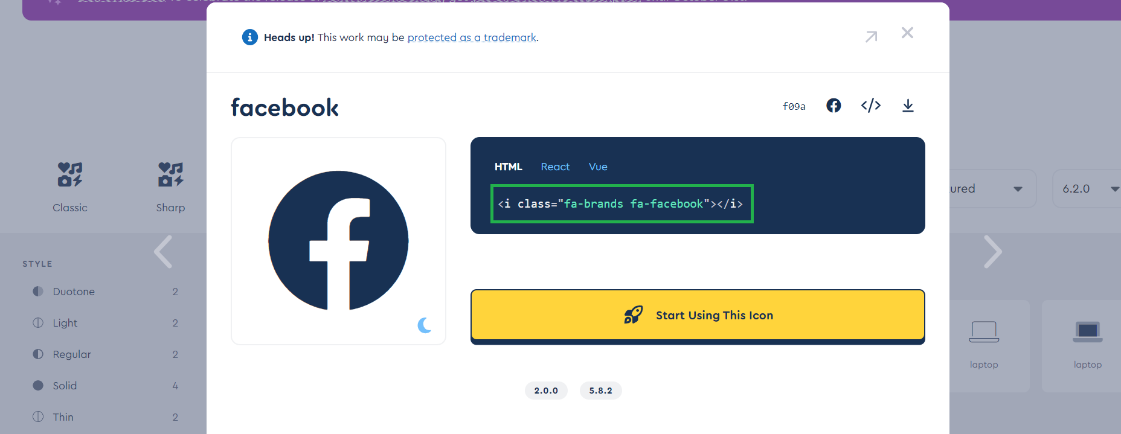
How To Use Icons ?
7) Copy and use it
Copy its HTML code by clicking on it
Paste it in your HTML page

Slide 41
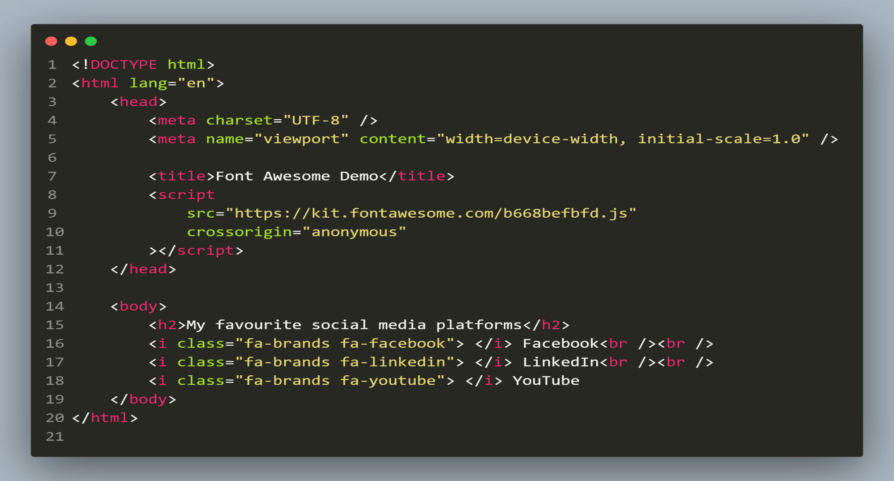
Final Code

Slide 42

Output

Slide 43
Customizing Icons
Font Awesome allows us to customize the icons.
We can do this by simply adding our own class to the icons
And then we can add CSS code to these classes

Slide 44
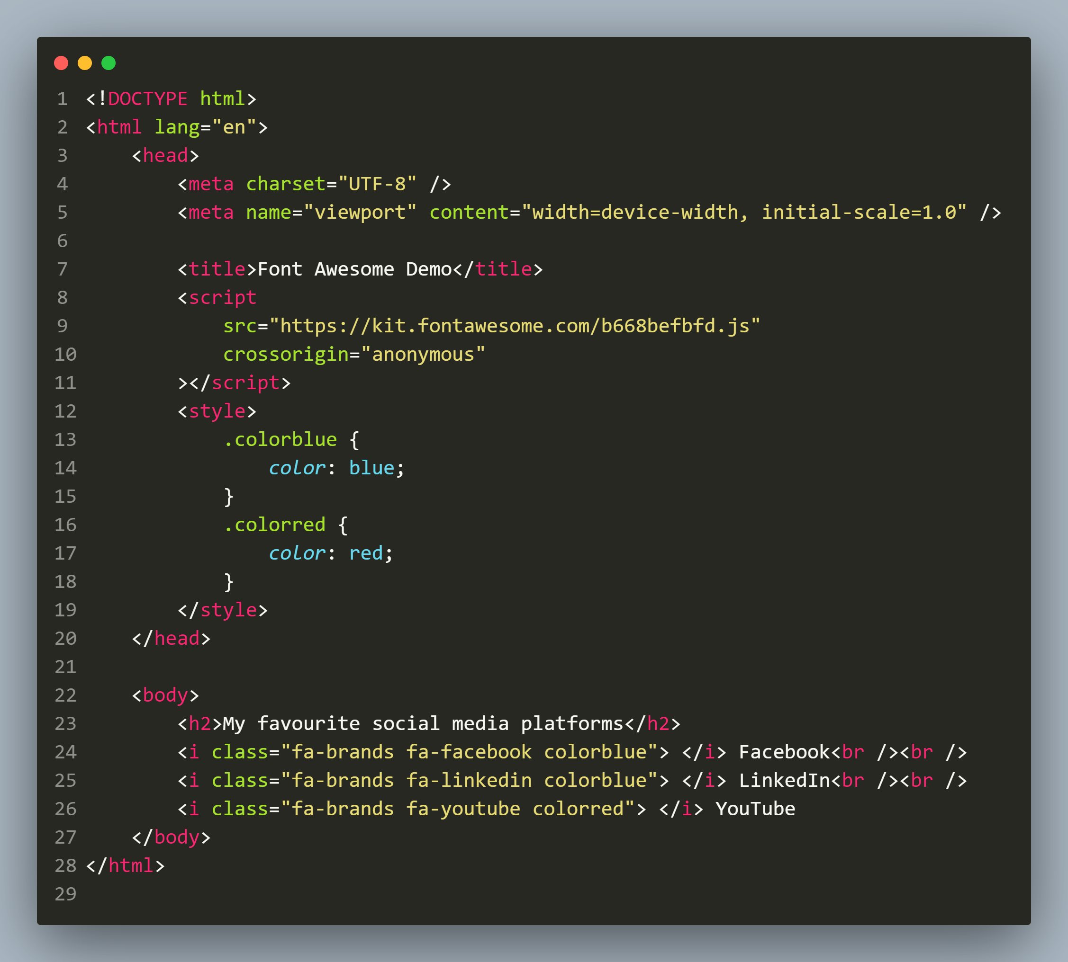
Code To Change Color Of Icons

Slide 45

Output

Slide 46

End Of Lecture
For any queries mail us @: scalive4u@gmail.com
Call us @ : 0755-4271659, 9826686245
Agenda for Next Lecture:
Handling Text In CSS

